Slide 1



STUDENT EXCUSE AND ABSENCE REQUEST MANAGEMENT SYSTEM
A PROJECT PROPOSAL

Slide 2

STUDENT EXCUSE AND ABSENCE REQUEST MANAGEMENT SYSTEM
Project Documentation PHINMA Araullo University – South College of Information Technology Bachelor of Science in Information Technology S.Y. 2026–2027 | First Semester ITE 302 – Information Assurance and Security 1

Slide 3
PROJECT TEAM:
DEVELOPMENT TEAM
Bana, Ryu Julian
Barrera, Mhike
Bartolome, Jaspher
Dela Paz, Prince Lance
Esqueho, Sean
Mendoza, Lord G.

Slide 4
PROJECT OVERVIEW

Slide 5
PROJECT OVERVIEW
The Student Excuse and Absence Request Management System is a proposed digital application designed to manage student excuse and absence requests.
Students can submit their requests through the system, while authorized users can review, approve, or deny them.
The system also keeps digital records of requests, making them easier to search, monitor, and manage while protecting student information.

Slide 6
PROJECT DESCRIPTION

Slide 7
PROJECT DESCRIPTION
The project aims to improve the traditional process of submitting excuse and absence requests. Instead of relying mainly on paper forms, students can submit their requests digitally.

Slide 8
SYSTEM DESIGN TO?
Reduce paperwork
Make submissions easier and faster
Help school personnel manage requests
Reduce lost documents
Reduce processing delays
Keep absence records organized and secure

Slide 9
PROBLEM STATEMENTS

Slide 10
MANUAL SUBMISSION OF REQUEST
Students currently may need to submit excuse and absence requests manually.

Slide 11
THIS PROCESS CAN BE:
This process can be:
Time-consuming
Inconvenient
Dependent on paper forms
Paper forms may also be:
Lost
Damaged
Submitted late

Slide 12
PROPOSED SOLUTION #1:
The proposed system allows students to submit their absence requests online.
Students can also attach supporting documents to their requests.

Slide 13
BENEFITS:
Less paperwork
Faster submission
More convenient for students
Digital storage of requests
Easier processing for authorized personnel

Slide 14
DIFFICULTY IN MONITORING REQUEST STATUS:
Students may not know whether their absence request is:
Pending
Approved
Denied
School staff may also spend additional time checking records and answering questions about request updates.

Slide 15
Proposed Solution #2
REQUEST STATUS MONITORING
The system will allow students to monitor the status of their submitted requests.
Authorized staff can update the request status.
This improves communication between students and school personnel and reduces repeated inquiries about request updates.

Slide 16
UNORGANIZED AND INSECURE RECORDS
Manual records can be:
Lost
Damaged
Difficult to locate
Accessible to unauthorized people
These issues can affect the accuracy and privacy of student information.

Slide 17
Proposed Solution #
The system will store absence requests in a secure database.
Only authorized users will be given access to student records.
This makes records:
Easier to manage
Easier to find
More organized
Better protected from unauthorized access

Slide 18
Information Assurance and Security

Slide 19
Information Assurance and Security:
CONFIDENTIALITY
Only authorized users can access student requests and uploaded files.
INTEGRITY
The system helps prevent fake or altered excuse documents and records important system activities.
AVAILABILITY
The system is designed to remain accessible when needed through backups.
AUTHENTICATION
Users must log in before accessing the system.
NON-REPUDIATION
System activities are recorded so actions such as approvals and submissions can be traced.

Slide 20
CONFIDENTIALITY:
PROTECTING STUDENT PRIVACY
Only the following authorized users should be able to view request details and uploaded files:
The student who submitted the request
Their adviser
School administrator

Slide 21
The system plans to use:
User roles
Data encryption
Access controls

Slide 22
INTEGRITY:
PROTECTING THE ACCURACY OF REQUESTS
To help prevent fake or altered excuse documents, the system plans to:
Require PDF or JPG proof documents
Check whether uploaded files have been edited
Record important system activities
The system will maintain an activity log containing information such as who approved or rejected a request and when the action occurred.

Slide 23
Availability and Authentication:
AVAILABILITY
The system is planned as a website and mobile application so students and teachers can access it when needed.
Daily backups will also be implemented to reduce the risk of losing data.
AUTHENTICATION
Users must log in before using the system.
Students use their student ID and password.
Teachers and administrators use their school accounts.
OTP verification is planned for the first login.

Slide 24
Non-Repudiation:
ACTIVITY TRACKING
The system will automatically record important activities. For example, when a teacher approves or rejects a request, the system can record:
Teacher's name
Date
Time
Action performed
Students' submitted requests will also remain in their account history.
This provides a record of important actions performed within the system.

Slide 25
Secure Coding Measures:
The system will use several security measures, including:
HTTPS for secure communication
Password hashing to protect account passwords
Input validation to prevent invalid data
Safe database queries
User authentication
Access control
The proposed technologies include Laravel and MySQL.

Slide 26
SECURE CODING AND DEFENSIVE PROGRAMMING

Slide 27
Defensive Programming Plan:
The system will validate and sanitize user inputs such as:
Student identifiers
Dates of absence
Reasons for absence
Other submitted information
The system will also include error-handling and recovery mechanisms.
Security checks and default-denial rules will be applied to operations involving:
Student data
Excuse letters
Absence requests
Approvals

Slide 28
Secure Coding Plan:
The system will follow secure coding practices to protect student and teacher information.
These include:
Validating user inputs
Securely storing passwords
Using safe database queries
Preventing SQL injection
Implementing authentication
Implementing access controls
These practices help protect student records and excuse documents from unauthorized access.

Slide 29
Expected Benefits:
FOR STUDENTS
Easier submission of absence requests
Faster processing
Ability to monitor request status
Less dependence on paper forms

Slide 30
Expected Benefits:
FOR TEACHERS AND SCHOOL STAFF
Easier request management
Faster access to records
Better monitoring of requests
Reduced paperwork

Slide 31
Expected Benefits:
FOR THE SCHOOL
More organized records
Improved privacy and security
Reduced risk of lost documents
More efficient absence-request processing
Slide 20 — Conclusion

Slide 32
Consclusion:
The Student Excuse and Absence Request Management System provides a digital approach to submitting, processing, monitoring, and managing student absence requests.
By replacing manual processes with a secure digital system, the project aims to make absence-request management faster, more organized, convenient, and secure.
The proposed security measures also help protect student information and maintain the integrity of absence records.

Slide 33
Account login

Slide 34
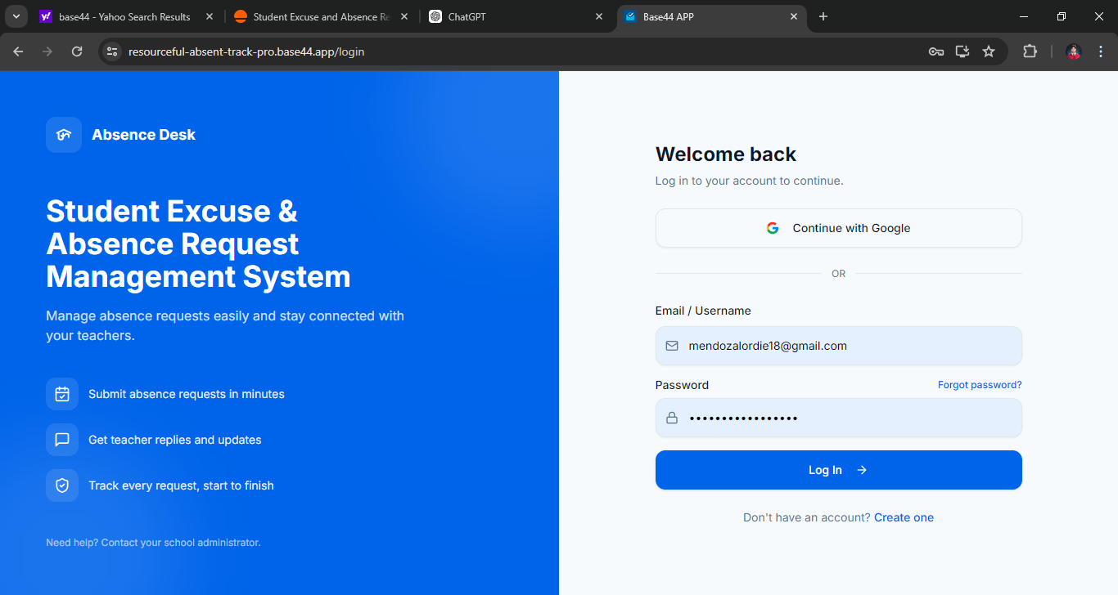
Account log in

Slide 35
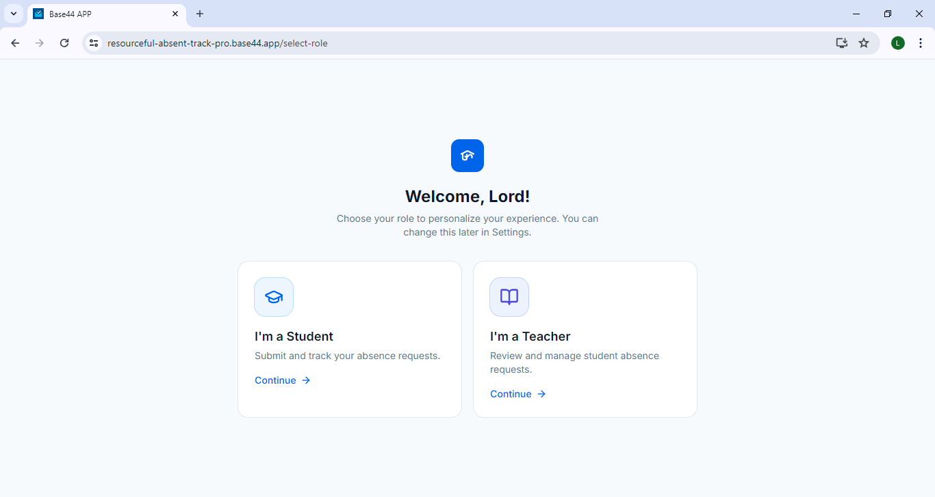
Account log in

Slide 36
Student portal

Slide 37
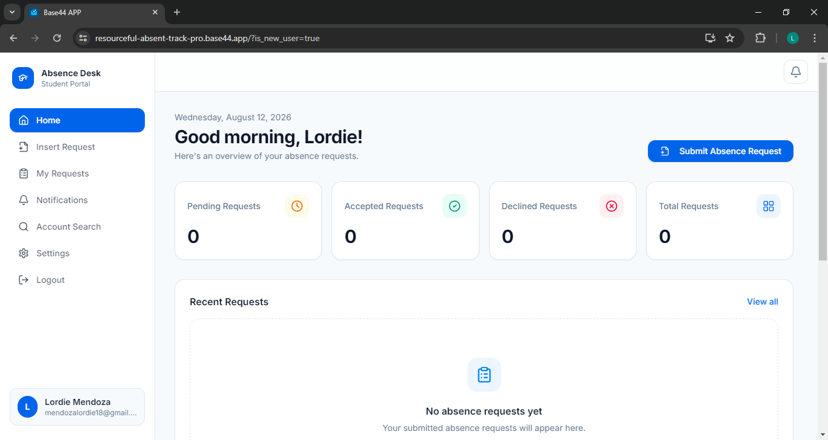
Student portal

Slide 38
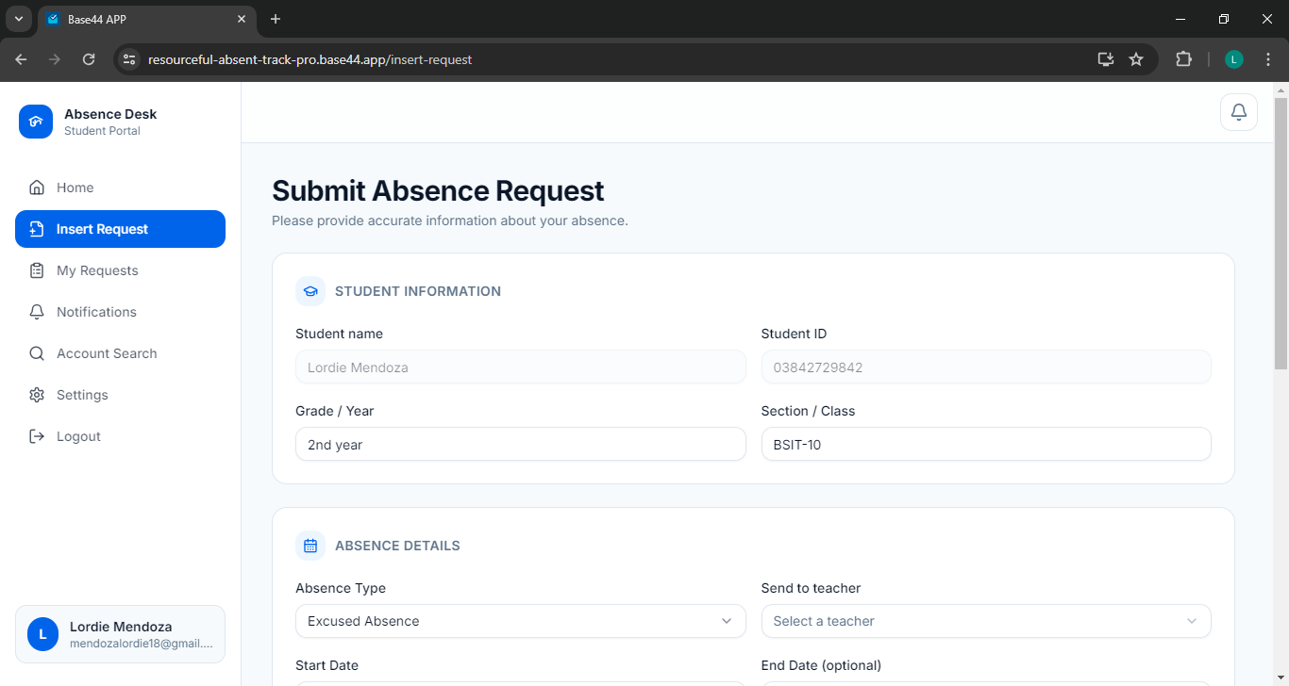
Student portal

Slide 39
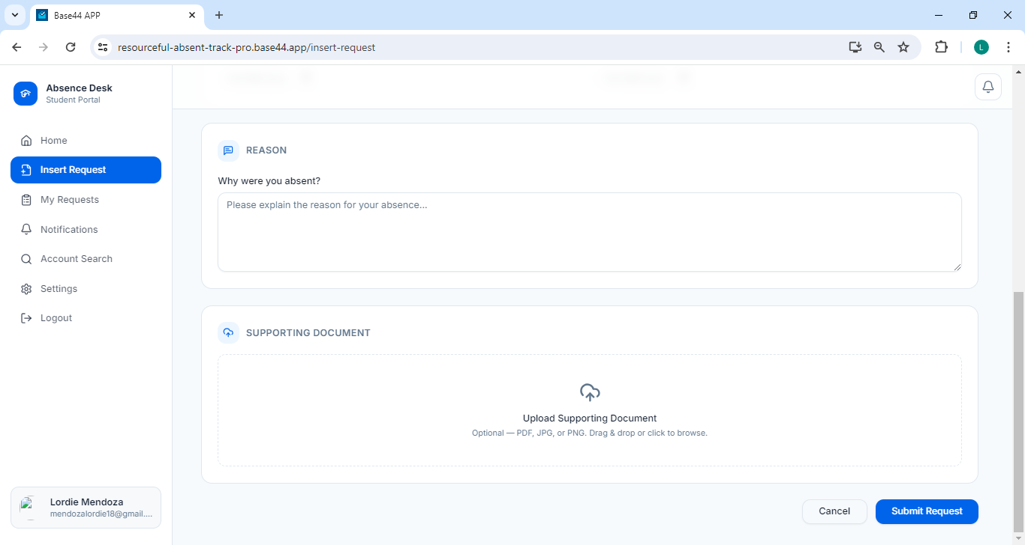
Student portal

Slide 40
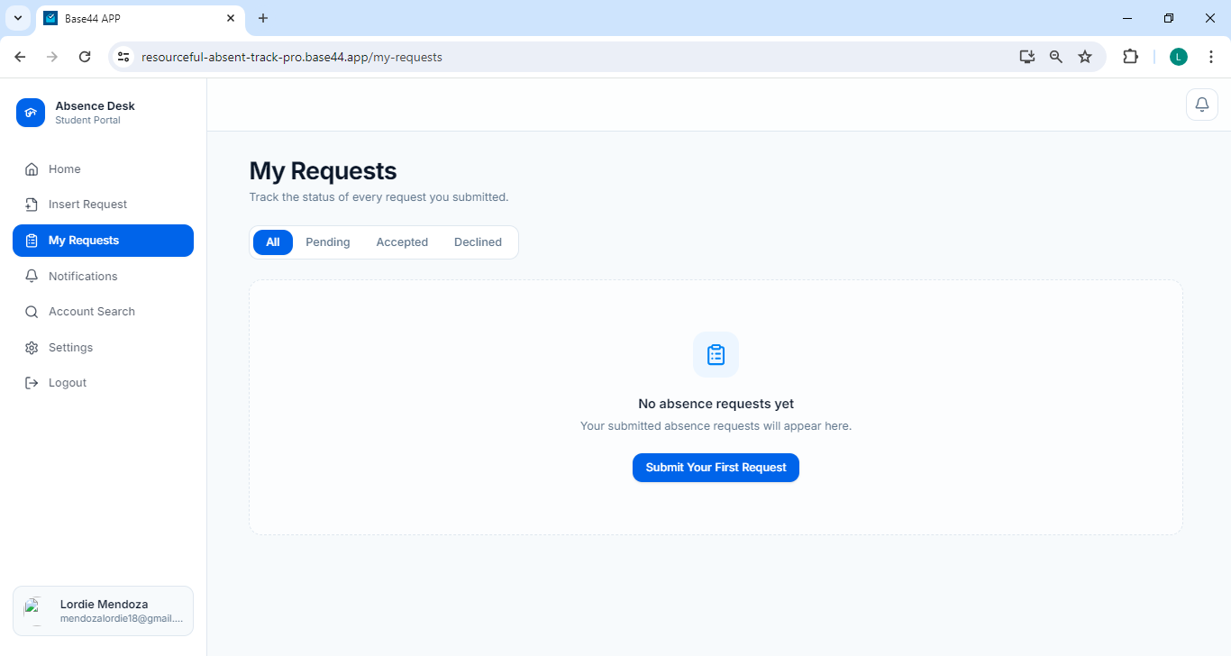
Student portal

Slide 41
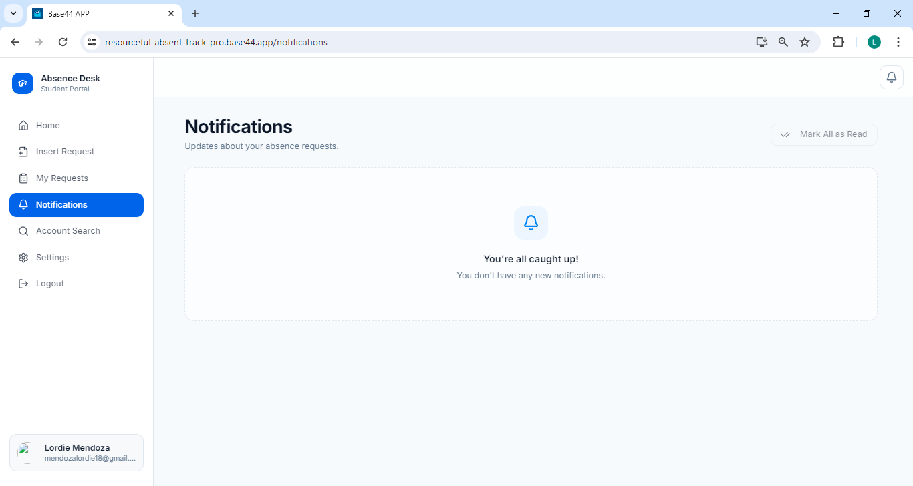
Student portal

Slide 42
Student portal

Slide 43
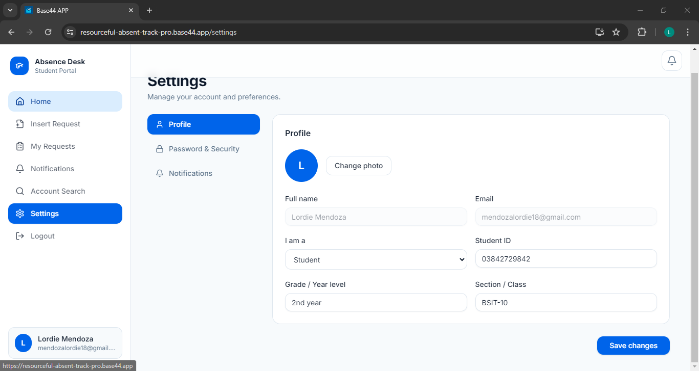
Student portal

Slide 44
Student portal

Slide 45
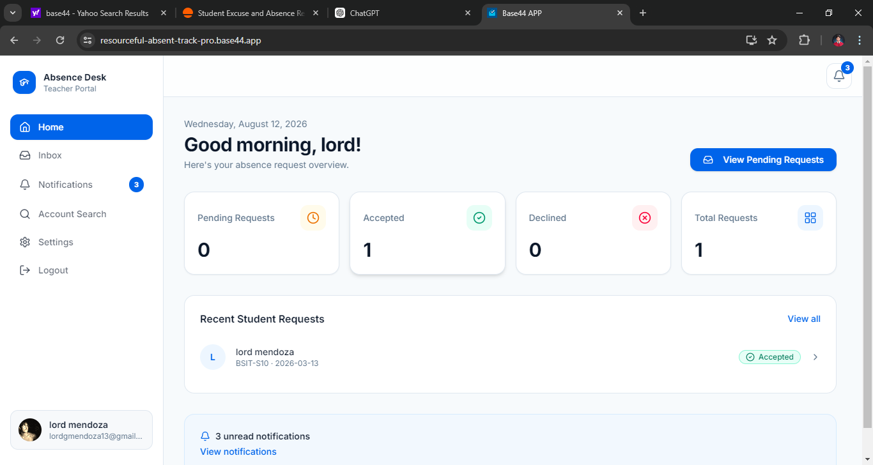
Teacher portal

Slide 46
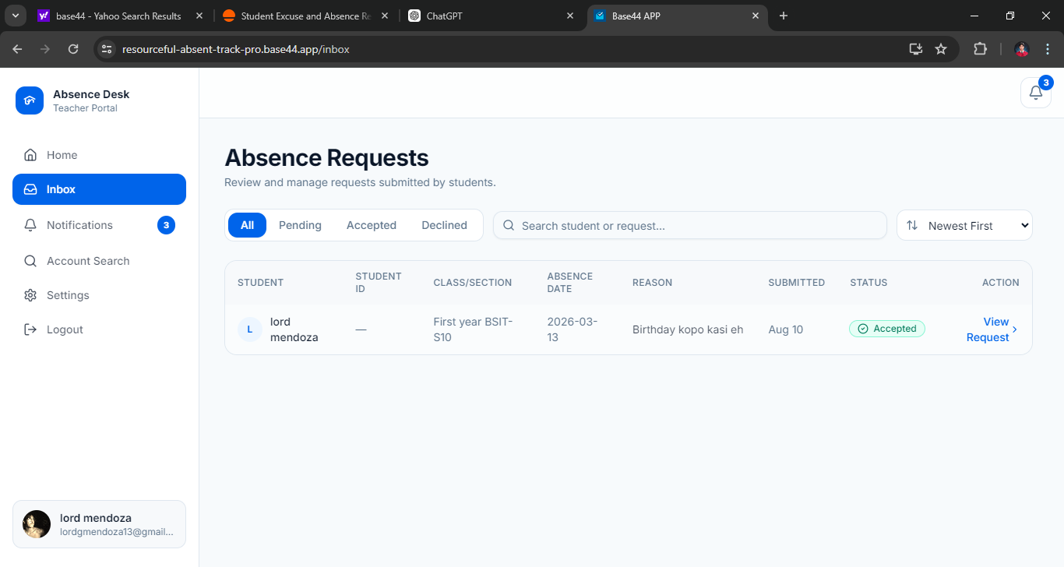
Teacher portal

Slide 47
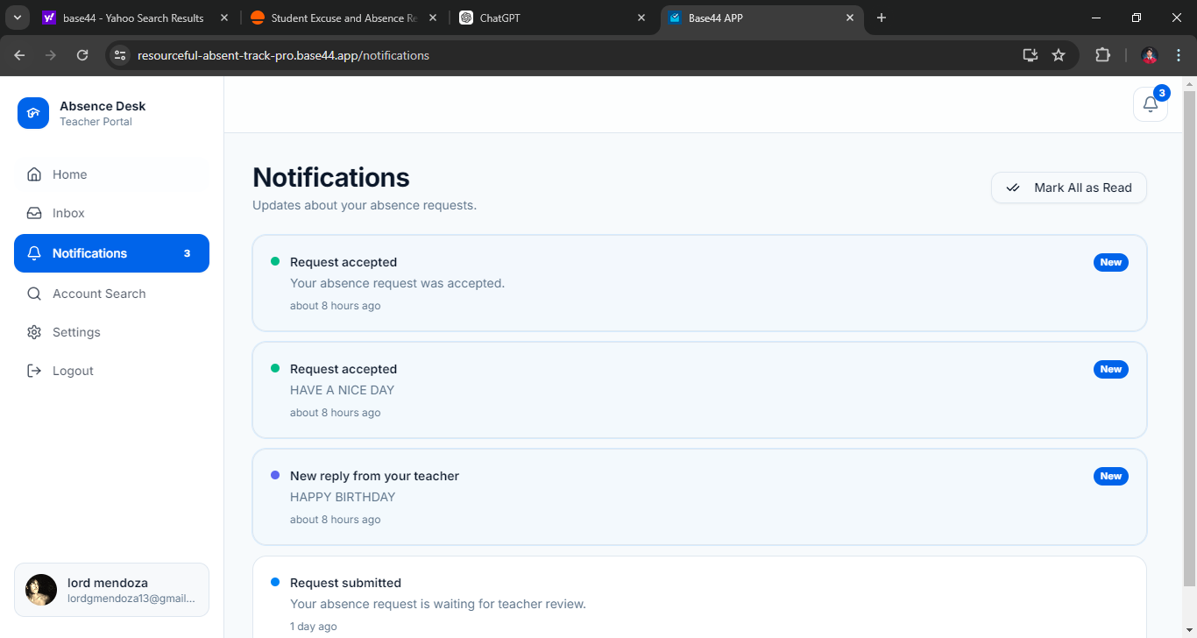
Teacher portal

Slide 48
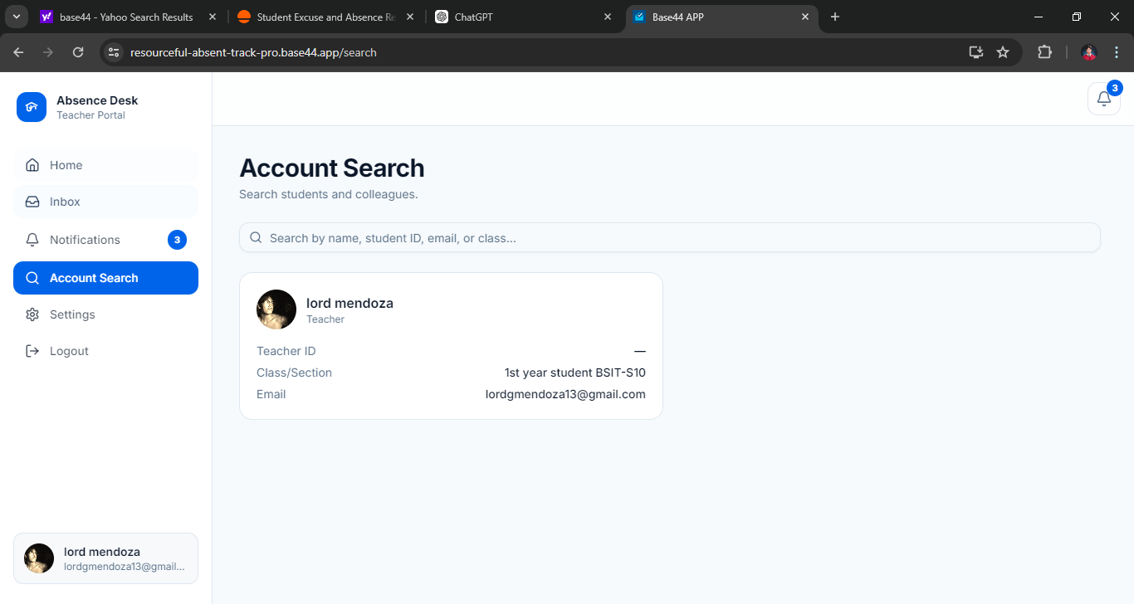
Teacher portal

Slide 49
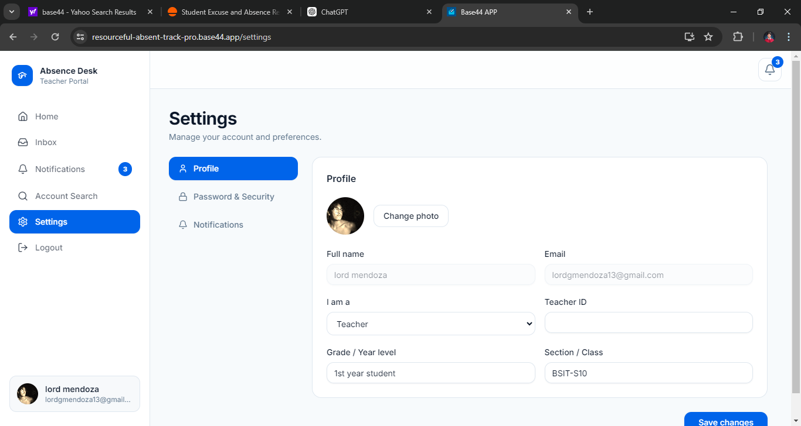
Teacher portal

Slide 50
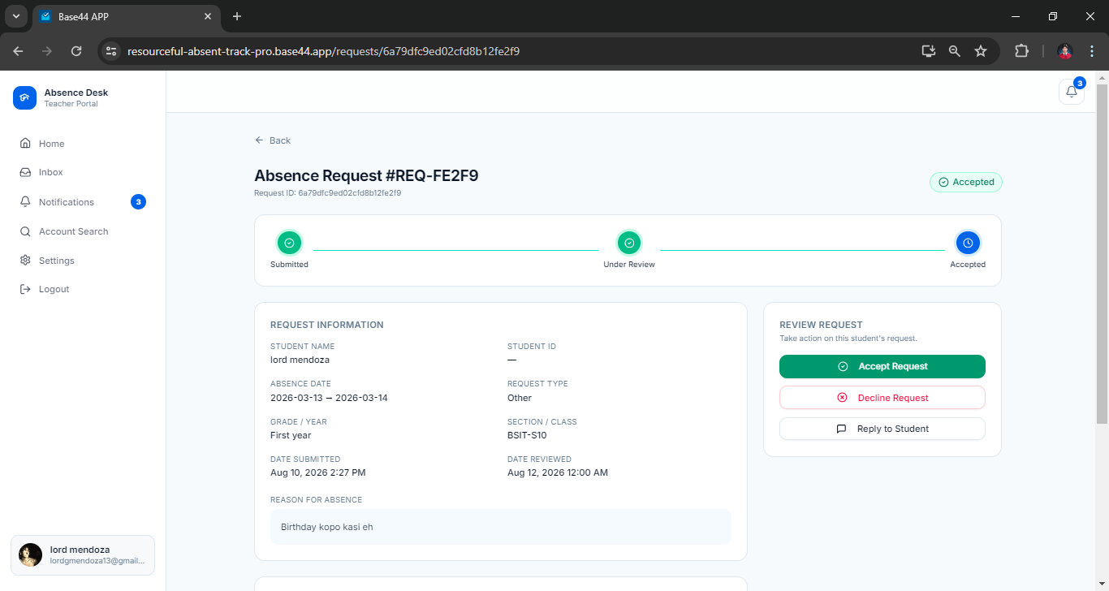
Teacher portal

Slide 51
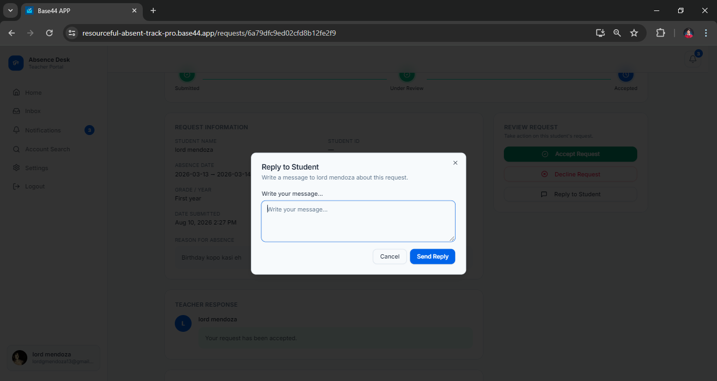
Teacher portal

Slide 52
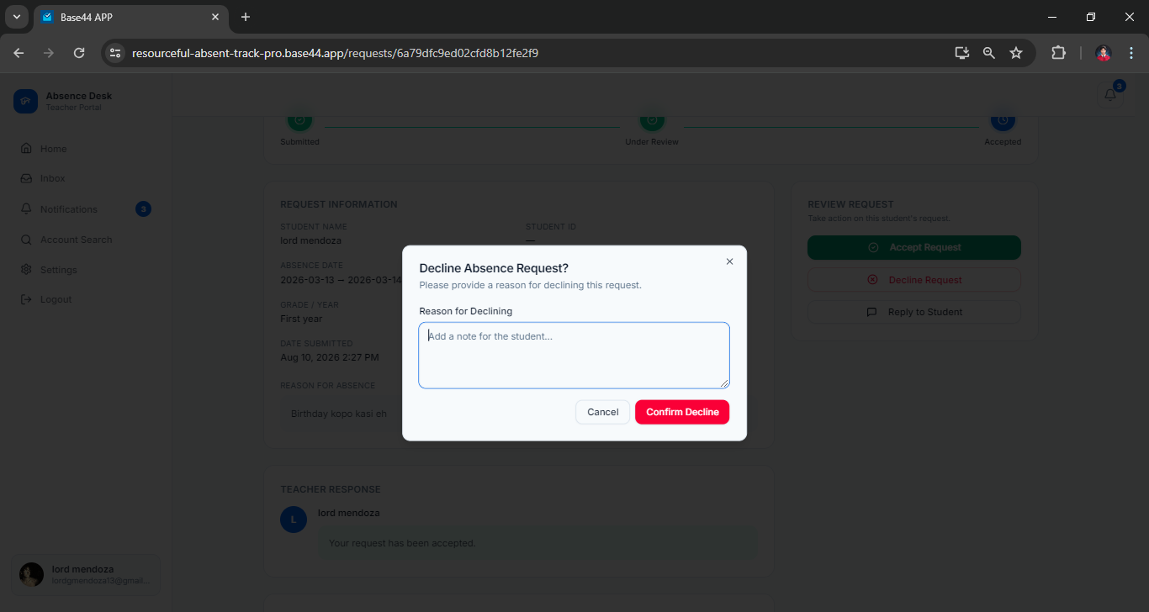
Teacher portal

Slide 53
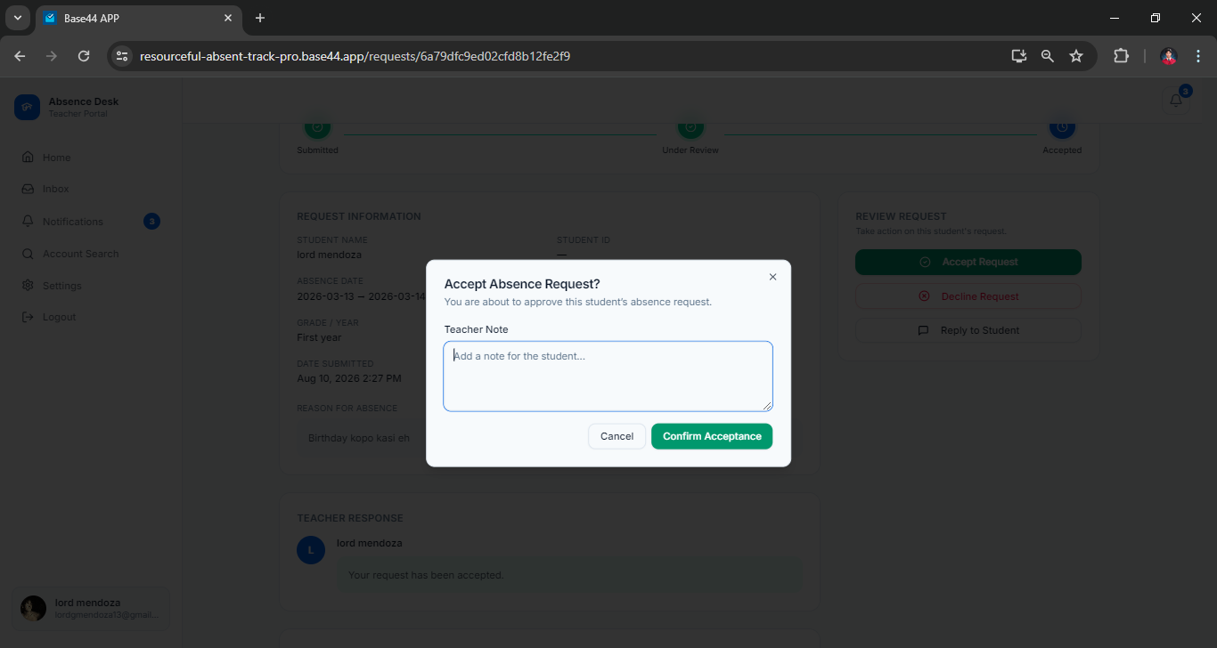
Teacher portal

Slide 54
THANK YOU!!!!!!!!!!!!!!!!!!!!!!!!!!!!!!!!!!!!!!!!!!!!!!!!!!!!!!!!!!!!!!!!!!!

